Slide 1
Control net based innovation

Slide 2
Background
We use mostly word as prompt in AI drawing, however, the essence of a picture can be more precisely represented by another picture. People will have better experience when creating prompts with the same method expressing information.
Final goal: recognize all prompts in only one picture, whether it contains word / structure / color and other prompts.

Slide 3
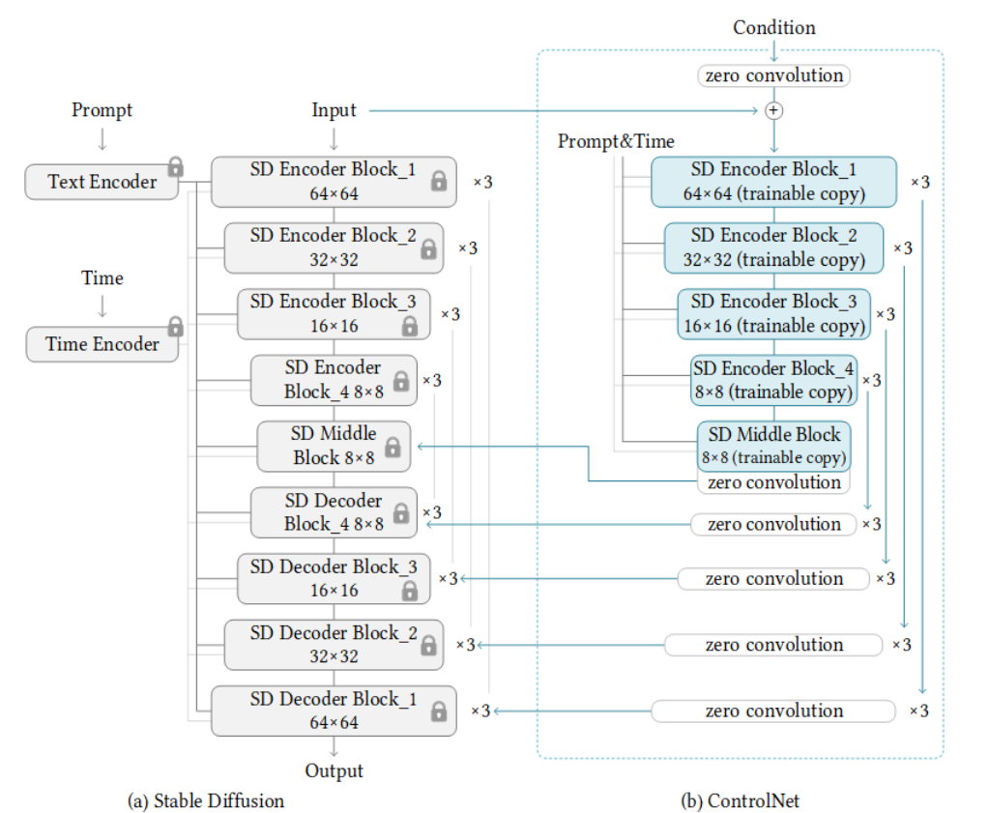
Introduction
Conditional control used in stable diffusion.
Popular
Novel

Slide 4
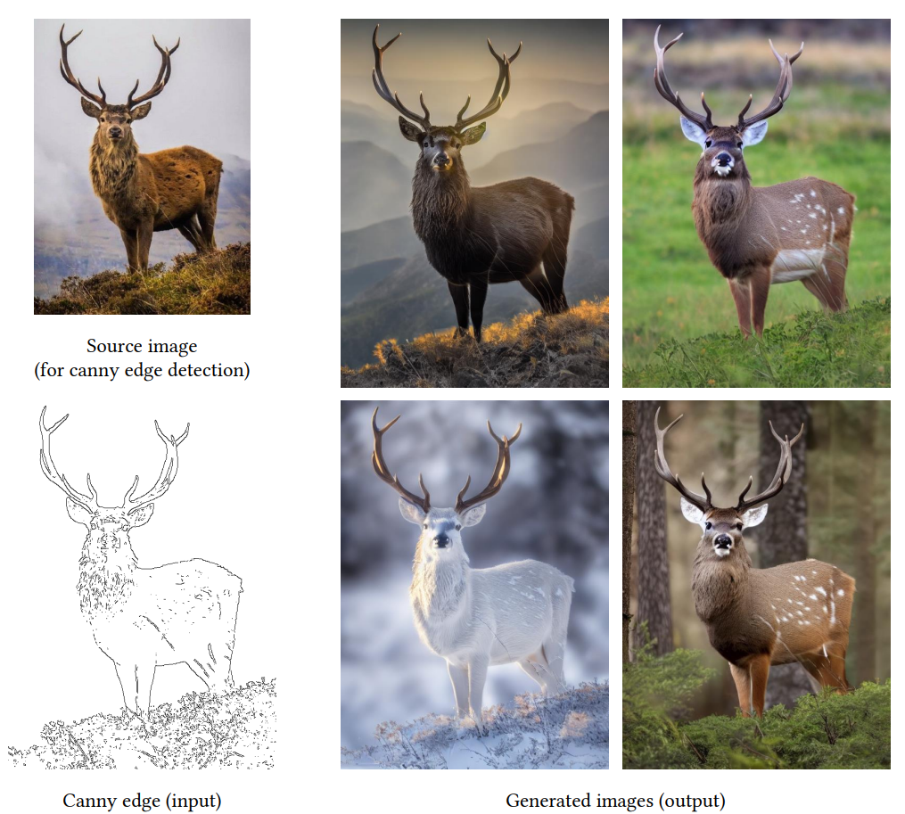
Introduction
Use several patterns of drawing as additional control to generate pictures.

Slide 5
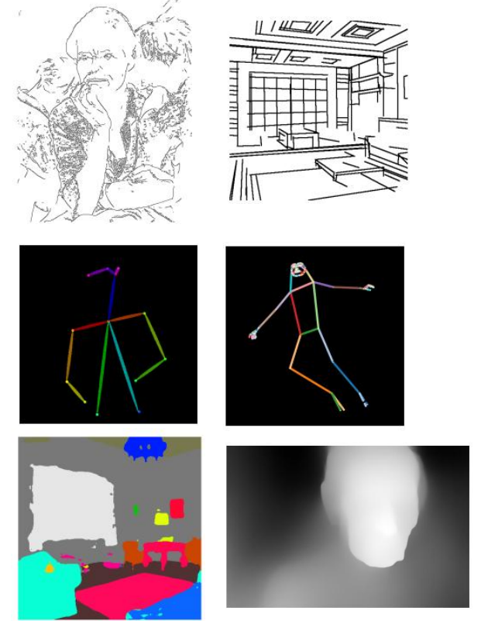
Introduction
Current controls contain:
Canny edge / Hough line
Skeleton
Segmentation maps
Depth maps

Slide 6
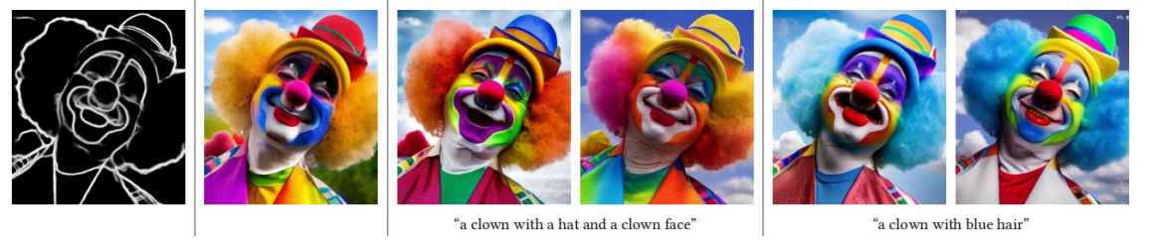
Ideas
Create a new pattern of conditional control.
May need help from art field
Make the condition provide information more than structure(for example color).
Advanced:
add information beyond color like word description
Compare the whether directly convey the info to the network works better than traditional word prompt

Slide 7
Ideas
Create a new pattern of conditional control.

Slide 8
Schedule
7.17 create ideas , deploy Controlnet.(due to the hotel WIFI always disconnect, may delay to the next day)
7.18-7.20 read paper-Adding Conditional Control to Text-to-Image Diffusion Models Lvmin Zhang and Maneesh Agrawala Stanford University and read source code.
7.21-7.23 implement the base idea
7.24-7.25 buffer for base implementation and advanced ones if possible.
7.26-7.28 essay writing

Slide 9
Risks
1. Technical risk
How to convey the information to the stable diffusion model.(idea2)
Which aspect to choose as a new pattern and how to implement.(idea1)
Solution: ask professor and ta for help / select easier ideas / simplify the idea / …
2. Progress risk
Only 14 days to finish a program is too limited.
Solution: suppress the time of writing assay by using ai, cut unimportant parts of ideas.

Slide 10
Current expectations
more constructive ideas
technical guides

Slide 11
Other possible orientations
1. Parallelized GD
When we use mini-batch in SGD training, each batch has no data-relation and thus we can just use threads without locks to implement parallel SGD.(easy and with low research value)
In one training set, data race may happen, and it’s worth trying training different study rate in parallel, and store them in a global queue(need lock), updating the parameter each time. Therefore, we may reach the least train time(large learning rate) with good result(low learning rate).(hard but actually may also lack research value. It’s just an idea.)

Slide 12
Other possible orientations
2. Sorting methods in mini-batch / few-shot learning
Use K-D tree to sort the huge dataset into a K-D tree.
Use K-D tree sorted dataset to choose proper data each batch to obtain better outcomes.

Slide 13
Thanks for listening

